Slide 1
R Shiny for Operations
Instructor: Geoffrey Arnold

Slide 2
Agenda
Course Details
Introductions
Shiny Examples
Digital Services
R Projects
Git & GitHub

Slide 3
Course Details

Slide 4
Class Logistics
There is no required text for this course, but supplemental websites and materials will be provided
There will 2 graded projects and 3 homework assignments
The lowest homework grade will be dropped
Each student will be required to submit their own code for assignments but working with a partner or group is encouraged.
Assignments will be due on Fridays at Midnight
Syllabus & Homework

Slide 5
Homework Rubric
Standard | Weight | 100-90 | 80-89 | 70-79 | 60-69 | 50-0
Code Standards | 20 | All code meets Style Guide standards | Most code meets Style Guide standards | Some code meets style Guide standards | Little code meets Style Guide standards | No code meets Style Guide standards
Git Commits | 30 | All git commits are clear | Most git commits are clear | Some git commits are clear | Few git commits are clear | No git commits are clear
App functionality | 60 | All assigned and extra elements and portions of the app work as expected | All assigned and a few extra elements and portions of the app work as expected | All assigned elements and portions of the app work as expected | Some assigned elements and portions of the app work as expected | None of the assigned elements or portions of the app work as expected
User Interface | 40 | All UI elements are clearly labeled and function properly | All UI elements are labeled and function properly | All UI elements function properly | Some UI elements function properly | No UI elements are labeled nor function properly

Slide 6
Course Schedule
Date | Class | Theme/Topic | Learning Outcomes Addressed | Assignment Due
August 28th | Class 1 | Course Intro - GitHub | Use git and versioning to save, revert and troubleshoot code.
August 30th | Class 2 | Basic concepts of R Shiny apps | How to create, develop and deploy R Shiny web applications.
September 4th | Class 3 | ggplot2, plotly, Outputs & Deploying to shinyapps.io | How to create, develop and deploy R Shiny web applications.
September 6th | Class 4 | Input Widgets, Filtering & Reactive Functions | Use R to generate interactive charts, maps, tables and graphs. | HW 1
September 11th | Class 5 | Shiny Dashboard & Flexdashboard | Use R to generate interactive charts, maps, tables and graphs.
September13th | Class 6 | Updates, Notifications, Values Lists, Events and Downloads | Use R to generate interactive charts, maps, tables and graphs. | HW 2
September 18th | Class 7 | Project Work Class
September 20th | Class 8 | Using API’s and Databases | Use Web API’s and DB Connectors to get data into Shiny applications. | Project 1
September 25th | Class 9 | Leaflet for R | Use R to generate interactive charts, maps, tables and graphs. | HW 3
October 1st | Class 10 | Promises & Future | How to create, develop and deploy R Shiny web applications.
October 3rd | Class 11 | CSS Tricks and App Design & Course Evaluations | Customize the appearance of their Shiny applications using Shiny and CSS. | HW 4
October 9th | Class 12 | Human Centered Design Tools | Use Human Centered Design principles.
October 11th | Class 13 | Deploy on your own – Shiny Server Community & Pro, ShinyProxy | How to create, develop and deploy R Shiny web applications.
October 13th | Class 14 | Project Work Class
October 16th | Reading Day | No Class
October 18th | Exam Day | Final Project Due, No Class |  | Project 2

Slide 7
R Style Guide
We will be using the Google R Style Guide for this course: https://google.github.io/styleguide/Rguide.xml#comments
Note the passage on commenting as all graded code will require comments so I know what your code is supposed to accomplish.

Slide 8
About the Instructor
Education:
University of Pittsburgh: BA Political Science & History 2010
Heinz College: MS PPM 2015
Professional:
PA State Democratic Party: Field Organizer 2010
City Year Greater Philadelphia: Senior Corps Leader: 2011-2012
Lutheran Child & Family Services: Group Leader 2013
City of Pittsburgh: Senior Digital Services Analyst 2015-Present

Slide 9
What are digital services?
Eh?

Slide 10
US Digital Service & 18 F
“The mission of the U.S. Digital Service is to deliver better government services to the American people through technology and design.”
https://www.usds.gov/mission.html
“We develop partnerships with agencies to help them deliver exceptional digital experiences that address their strategic initiatives. Through our work together, we also aim to strengthen government technology practices in ways that last beyond our formal partnerships. We effect change by practicing user-centered development, testing to validate hypotheses, shipping often, and deploying products in the open.”
https://18f.gsa.gov/about/

Slide 11

How do you do that in Pittsburgh?
We’ve developed end-user applications in R, HTML, JS and more to help City Departments do their work by building custom applications.
Examples
Burgh’s Eye View (public)
Maintenance Request Form
Pothole Dashboard
And more

Slide 12
Introductions
Name, Year, Program, Experience with R

Slide 13
Shiny
Examples

Slide 14
Shiny App Showcase
Burgh’s Eye View:
Points
Parcels
Places
Basic App:
Distribution Calculator
Shiny Dashboard:
Imagine Boston
Map:
Superzip
Flexdashboard:
CRAN
Pokémon Dashboard

Slide 15
R Projects
Easy Organize your Code

Slide 16
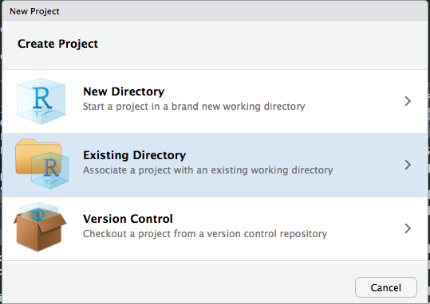
Why R Projects?
R Projects are great for if you’re working on multiple analyses/apps
When you load a project your Objects from the last time you were working on it are brought over
You had to reload your Libraries, as opening a project starts a new R Session.

Slide 17
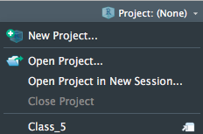
It’s not to late to convert to all your scripts to Projects!
If you’ve already started working on something and want to switch it to an R Project simple select Existing Directory
When you want to go back to this project you can select it from the project drop down
You can open projects in a “New Session” and have to different windows of R Studio running at the same time
Multitasking

Slide 18

Git & GitHub
The big save button in the cloud

Slide 19
GitHub What to do:
All course materials are available through GitHub: https://github.com/RforOperations2018/
Download GitHub for Desktop: https://desktop.github.com/
Create an account: https://github.com/join
Follow the Course repository (repo)
All of your projects should have their own GitHub repo.
This is so I can see what you tried, and also determine who did one on any group work.

Slide 20

What’s all this?
GitHub is a form of Git.
So what’s Git?
Git “provides access control and several collaboration features such as bug tracking, feature requests, task management, and wikis for every project.” -Wikipedia
There’s also GitLab
GitHub was bought by Microsoft in 2018, so some people want to be cool and use “indy” products
After this course you can switch to them if you have an aversion to using a Microsoft product

Slide 21
How to use Github
Select lines to “commit” to your code, add comments and title each commit.

Slide 22
Important things
.gitignore File
This is where you can hide things from the public repo.
Good for passwords or really large files
You don’t have to do all of your commits from your last change at once.
This is helpful if you changed multiple things that were unrelated.
Best practices:
Save all passwords, API keys in an “.REnviron” file or some of file type and add that file to load into your application

Slide 23
Practice

Slide 24
Git in R Studio
Once you’ve installed GitHub Desktop, you don’t have to use Desktop

Slide 25
A Brief History of Git
People used to store their code on a single server. (at the City of Pittsburgh we used subversion)
Centralized
No branches, instead entire copies of changes would be in separate folder/file systems
Not great at scaling
Git was created in 2005 as an open source software, by Linux creator Linus Torvalds
Every computer has a full repository of the code
Faster
Changes are made and eventually “pushed” to the host
Users can “pull” changes from the host, create new branches of the code and eventually “merge” them back into the code.

Slide 26
Where is it?
In your top right tabs
Note: You’ll probably need to restart RStudio

Slide 27
Linking an R Project and GitHub

Slide 28
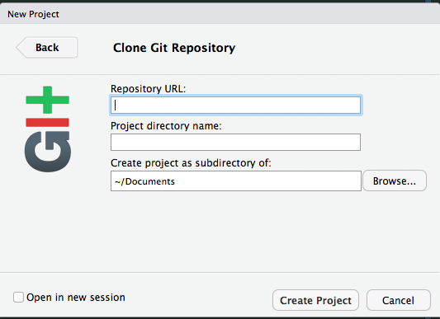
Linking an R Project and GitHub
If you’re bringing in a repo from GitHub that has already been published you use the Version Control option

Slide 29
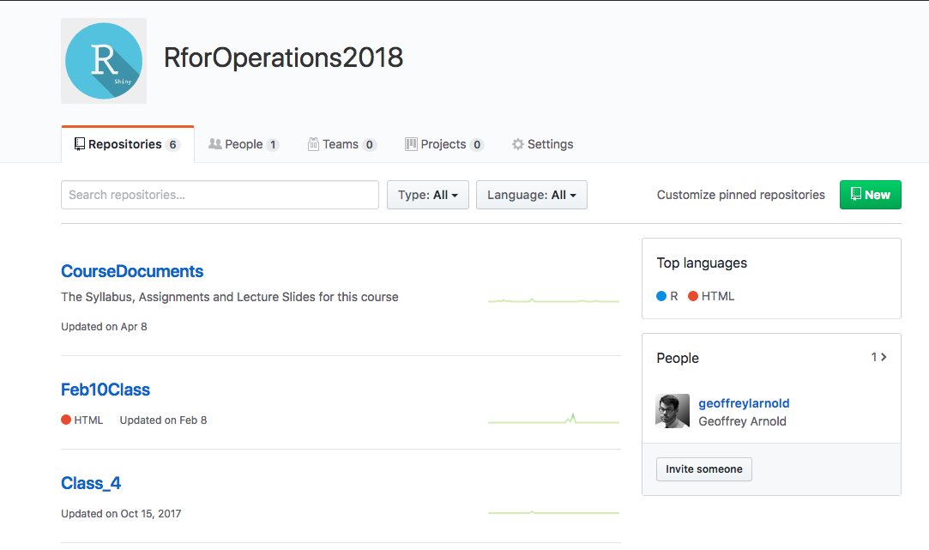
GitHub Website
You can add repos from here or by publishing them from GitHub Desktop

Slide 30
Practice

Slide 31
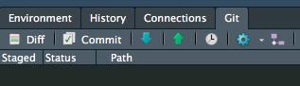
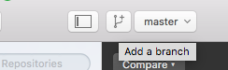
Branches
Branches are great for when you are making major revisions or testing out a change to your application that you’re not ready for.

Slide 32
Getting Help
Having a GitHub Repo is one of the easiest ways for me to help you in debugging your code. However check these great resources before coming to me!

Slide 33

Git-ing in Terminal/CMD

Slide 34
It’s actually not that scary. But, UI’s feel nice and safe
Command Line Documentation: https://git-scm.com/docs
You’re only looking into this sort of stuff when you mess up real bad.
Sometimes files are too big to commit and you have to remove them from your commits (I do this often)
https://help.github.com/articles/removing-files-from-a-repository-s-history/

Slide 35
REVIEW
Through this course you will be members of the Digital Services Revolution!
R Projects are great, they’re the best. Use them in this course and for the rest of your life.
Git is where all the course Documents are, it’s also where I will be taking submissions for assignments.
This really matter if you need assistance
Next Time: Intro to R Shiny & Core Concepts

